Slide 1
Africa’s growth tragedy: a retrospective 1960-89
By william easterly and ross levine
Presented by berk turfanda

Slide 2


Authors
William Easterly - Professor of Economics at New York University and Co-director of the NYU Development Research Institute
Ross Levine - Willis H. Booth Chair in Banking and Finance at the Haas School of Business, University of California – Berkeley
This paper is a joint product of the Macroeconomics and Growth Division and the Finance and Private Sector Development Division as part of a larger effort to understand the link between policies and growth

Slide 3
Overview of Presentation
Introduction
Understanding African economic growth
Using cross-country regressions to explain growth
Core Regression
Assessing Africa’s Performance
Two other explanations for African growth
Infrastructure
Ethnic Diversity
The Neighbors
Neighbor spillover
Neighbor multipliers
Conclusions
Contributions & Future research

Slide 4
Introduction: History
African economic history since the 1960s is a tragic story of unfilled potential. While many development economics clamored about Africa’s economic possibilities, the continent failed miserably to live up to expectations
Much of Africa has suffered negative per capita growth since 1960 (more information on following slide)
Out of the 20 poorest countries in the world, 16 are in Sub-Saharan Africa
More than economics statistics – real consequences
Typical mother has a 30% chance of all children surviving to age 5
Average life expectancy is only 48 years
Daily calorie intake is only 70% of Latin America/Asia

Slide 5
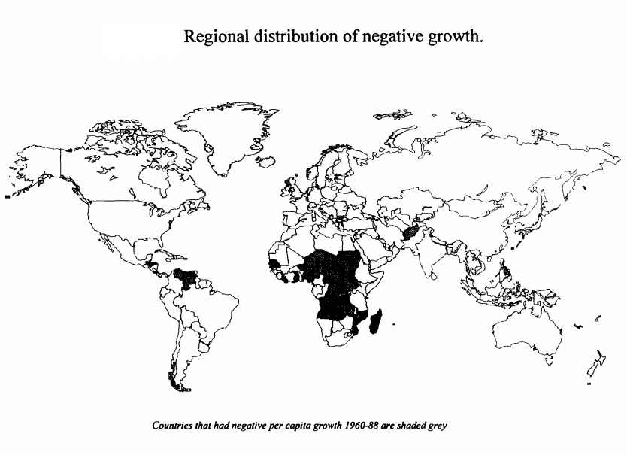

Slide 6
Introduction: reasons
Why has African economic growth been the slowest of any region in the world?
Rigorous country-studies identified a diverse set of potential causes:
Bad policies
Poor education
Political instability
Adequate infrastructure
Ethnic strife
The great challenge, then, is to find policy recommendations and strategies to fuel sustained development

Slide 7
Introduction: contribution
Easterly and Levine use cross-country regression to quantify the relationships of economic growth and a array of factors that may contribute to Africa’s ills
The analysis improves significantly on past attempts to account for the growth experiences of Sub-Saharan Africa
Affirms that low-school attainment, political instability, poorly developed financial systems, large black market exchange rate premia, large government deficits and inadequate infrastructure are associated with slow growth
Finds that Africa's ethnic diversity tends to slow growth and reduce likelihood of adopting good policies
Examines the neighboring country effect

Slide 8
Critique
The authors admit that the cross-country regression methodology does not establish directions of causality, and has numerous shortcomings
They correctly encourage others to use other methods to study growth and draw complimentary conclusions about Africa

Slide 9
Cross-country regressions
Attempt to focus on long-run growth – abstracting from business cycle fluctuations
193 observations using average annual growth rate of GDP per capita through the 1960s, 1970s, and 1980s

Slide 10
Cross-country regressions: core results
All of the variables were significant at the 0.05 significant level and of the anticipated sign
“countries with greater financial development, larger fiscal surpluses, and lower black market exchange rate premia grew significantly faster than countries with more shallow financial systems, large fiscal deficits, and sizable black market premia”
Also found that political assassinations are negatively correlated with long-run growth, while educational attainment is positively linked to growth
Results shown on Table 1

Slide 11
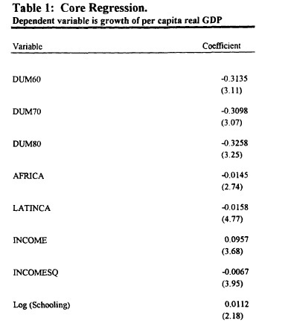
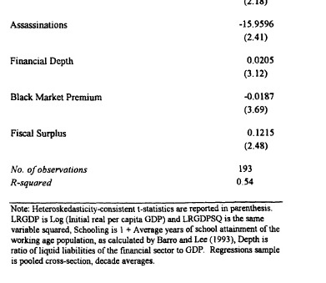
Table 1: Regression results

Slide 12
Cross-country regressions: assessing Africa's performance
The authors decomposed the core results and compared them with other regions of the world:
Africa seems to have worse policy indicators than other regions
The core regression attributes for 1.5 of the 2.3% difference in growth rates between non-African and African countries to the Africa dummy variable (which measures our inability to explain Africa’s growth)
The three policy indicators (black market premium, financial depth, budget surplus) combine for 0.9 of the 2.3% difference
Decomposition shown on Following Graph

Slide 13
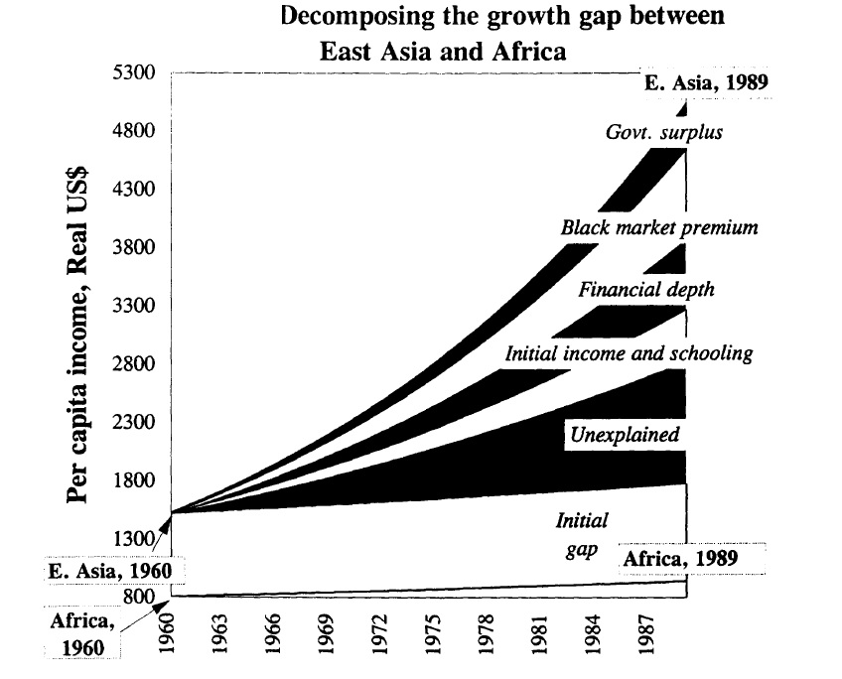

Slide 14
Two other explanations: infrastructure
In an attempt to explain Africa’s poor economic performance more thoroughly, the authors consider two other explanations, infrastructure and ethnic diversity
Many studies of Africa have argued that poor infrastructure may inhibit economic growth
The authors find: “the initial stock of roads/railways and initial electricity generation are not significantly correlated with future economic growth”
“we do, however, find a strong link between growth and telephones per worker”

Slide 15
Two other explanations: infrastructure
The authors conclude that although infrastructure seems to matter, the data does not provide enough to consider it a significant reason for Africa’s slow growth
They do, however, hope that more data can be obtained and studied in order to provide a stronger analysis
Critique: The argument is normatively strong, but the authors are not able to fully satisfy their hypothesis because of the lack of available data

Slide 16
Two other explanations: ethnic diversity
Ethnic diversity is a common characteristic among African countries – data suggests that 14 of the 15 most ethnically diverse societies in the world are in Africa
Wars, institutional weakness, bad policies, civil strife, political instability, destructive competition for rent, corruption, as well as an increased chance of destructive policies for long-run growth are all effects of ethnic diversity
The authors use a variable constructed by Mauro (1993) called the ETHNIC variable – the probability that two randomly selected individuals in a country will belong to different ethno linguistic groups

Slide 17
Two other explanations: ethnic diversity
Results:
ETHNIC is significantly correlated with growth, controlled for other factors
“The coefficient on the ethnic diversity variable implies that it accounts for 0.8 percentage points of the 2.3 percentage point gap between Africa’s growth and the rest of the sample”
Ethnic diversity is found to be negatively correlated with schooling attainment, with financial depth, and with all three infrastructure indicators (roads, telephones, electricity)
Positively correlated with black market premium
Therefore, the data implies that ethnic diversity independently accounts for about 35% of Africa’s growth differential with the rest of the world

Slide 18
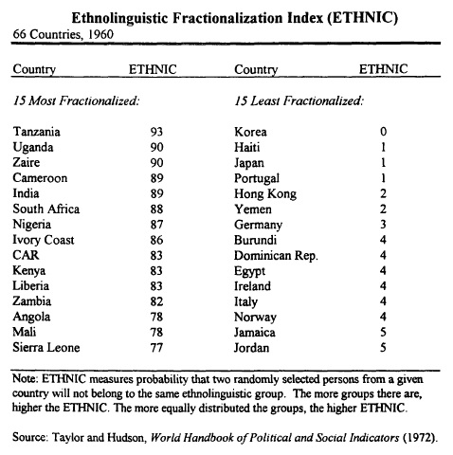
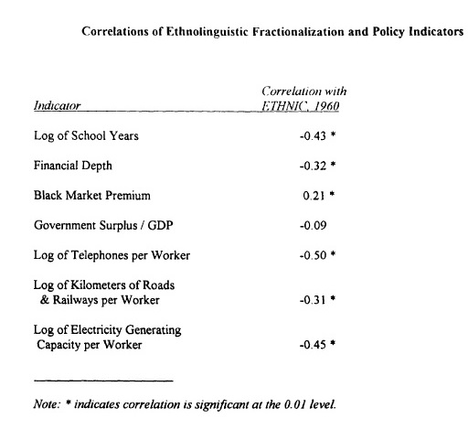
ETHNIC variable and regression

Slide 19
Two other explanations: ethnic diversity
“Thus, ethnic diversity slows growth directly and retards growth indirectly by making the adoption of good policies more difficult.”
Ethnic diversity seems to be a much more statistically based explanation for Africa’s slow growth than infrastructure
Critique: Ethnic diversity and tensions might be a result of conflicts, war, and political battles because of their poor economic situations

Slide 20
The Neighbors
Some studies have shown that general spillovers arise across borders, such as low investment or high political instability that may affect both countries
The authors expand an examination by Chua (1993) and Ades and Chua(1993) which looked into this neighbor spillovers
Changed the weights from equal to weighted by total GDP
Allowed for testing for direct contagion effects of growth success and failures

Slide 21
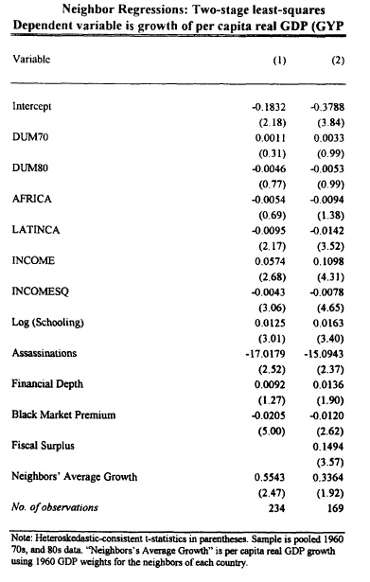

Slide 22
The neighbors
Results: “Each country’s neighbors’ growth has a surprisingly large and statistically significant effect on each county’s own growth: one percentage point more growth by the neighbors in a given decade translated into higher own growth of .55 percentage points.”
Although a spillover exists, the authors are unable to pin-point exactly where it comes from
The authors believe more research is necessary, and contribute by suggesting that “research on growth interactions between countries would be another fruitful area to add to the study of countries’ individual characteristics”

Slide 23
The neighbors: multipliers
The neighbor spillover effects may be hugely important for African growth in the future
Most African countries have 4 or more neighbors
If all countries act together, the ‘neighbor multiplier’ is much larger than if a single country acts alone
They find that, “a set of neighbors adopting a set of policy changes that would have raised growth by 1.04 percentage points if they had each acted alone will see growth increase by 2.2 percentage points if they act together.”
The results suggest that acting in unison has magnified effects (for good and for evil). Therefore, policy recommendations based upon this multiplier may be key for African economic growth

Slide 24
conclusions
The paper finds that poor growth is strongly associated with:
Low schooling
Political instability
Under-developed financial systems
Distorted foreign exchange market, as measured by the black market premium
High government deficits
Low infrastructure
Ethnic fractionalization
Spillovers from neighbors can magnify these variables

Slide 25
conclusions
The authors believe that their findings on ethnic diversity and contagion are two areas in which the paper has contributed, and more research should be done.
Ethnic diversity mechanisms might enable policy recommendations that can mitigate their effects
Contagion (neighbor spillover) can be used for both good and bad. Due to the amount of neighbors each African country has, neighbor spillover may be a key political mechanism to magnify economic growth

